Slide 1

Are You a Messenger or a Negotiator?

Slide 2
Extreme positions!
MV

Slide 3
Messenger Characteristics
To a seller’s request for a high asking price, the agent says “OK.”
“Well, that’s what they need to sell.”
To a buyer’s low offer on the home, the agent says “OK.”
“Well, that’s what they wanted to offer.”

Slide 4
Motivation
(focus on Client interests)

Slide 5
SELL

Slide 6
STAY

Slide 7

Focus on Interest, not Position
Position
Interest
WHY?

Slide 8
Away from Pain or Toward Pleasure?
Away | Toward
Out of debt Too much work Horrible climate Cramped living Painful memories Kids are gone Friends moved away | Upgraded new home Love the location Return to “home” city Close to (grandchildren, kids) Promotion to better job Start new life Join a SOI

Slide 9
Last home purchase

Slide 10
Seller interview: Facts, Feelings, Summarize
WHAT is the situation? How do they FEEL about it?

Slide 11
“That’s Right”
“Correct”
“Yes”

Slide 12


Negotiation resources

Slide 13
Expectations

Slide 14
False expectations
“I thought you were supposed to get me a good deal!”
“It sold to fast… we under priced!”
“This house will need a LOT of work.”
“We want the same price our neighbor got.”

Slide 15
Manage expectations
Reality is NOT the problem
EXPECTATION is the problem
Reality continues to be what IS

Slide 16
Educate clients before reality happens
Compensation
Home values
Multiple offers
Time to find a home
Inspections
Appraisals
Timing

Slide 17
Question their position

Slide 18
Question their position
Question their position, don’t defend your own
Ask how they arrived at that position

Slide 19
P.A.I.D for Objections
Pause
Acknowledge
Isolate
Discover
P
A
I
D

Slide 20
Sample questions
“How did you arrive at that price?”
“What will you do if it doesn’t sell at that price?”
“Why is having more experience important to you?”
Why is a lower commission appealing to you?”
“If you were to purchase this home anyway, how would you handle that?”

Slide 21
Objective standard

Slide 22
Provide an objective standard
Market Value is the ultimate objective standard
What is customary and reasonable?
Facts and data must set the basis for negotiation

Slide 23
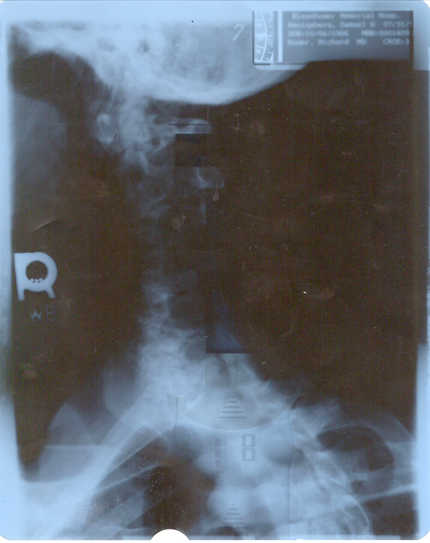

Slide 24
Feedback vs. Advice

Slide 25
Feedback Advice
Tells what could happen | Tells what to do
Empowering | Limiting
Let go | Control
They’re responsible | You’re responsible
Assertive | Aggressive

Slide 26
Law of contrast

Slide 27
Compared to what?
Perception is not absolute
Perception is relative
You’re going too fast/slow
It’s too hot/cold
That price is too high/low

Slide 28


Slide 29


Slide 30

Law of Contrast

Slide 31
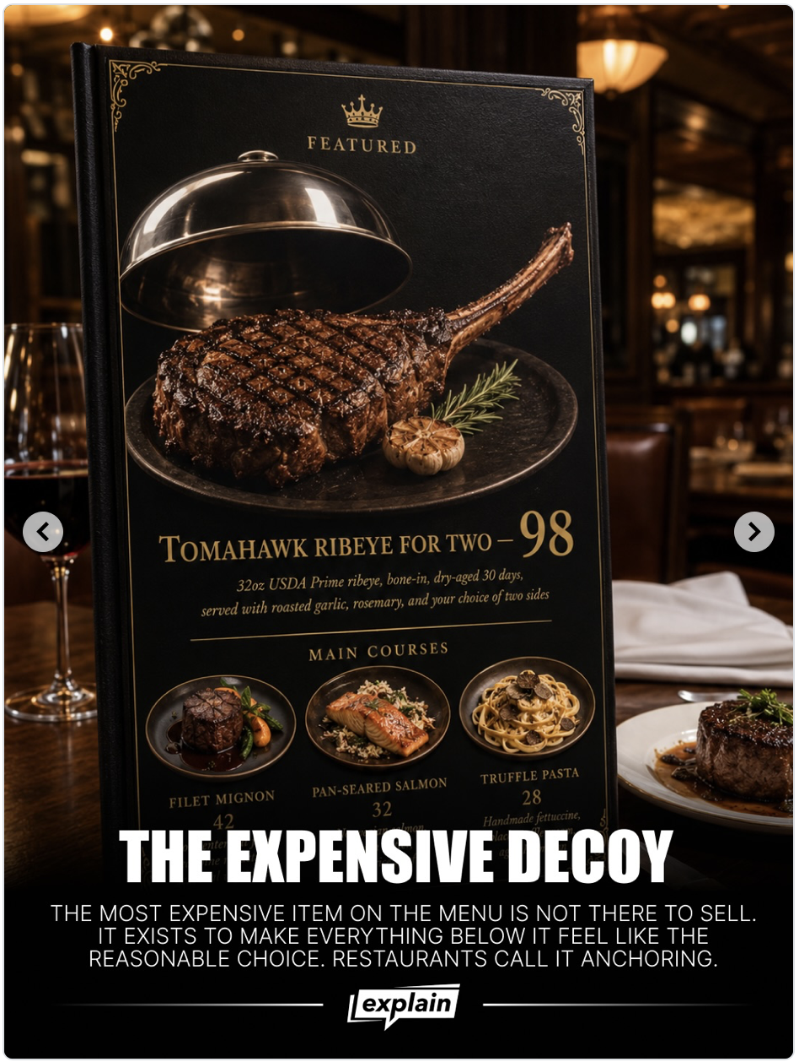

Slide 32
What do you present first?
[ ] Least desirable [ ] Most desirable
[ ] Low demand [ ] Highest demand
[ ] More expensive [ ] Least expensive
[ ] Shorter term [ ] Longer term
[ ] Higher % rate [ ] Lower % rate
[ ] High $ comps [ ] Low $ comps

Slide 33
Discuss differences not whole amounts

Slide 34
Don’t sell the “whole thing”

Slide 35
Contrast difference to whole value

Slide 36
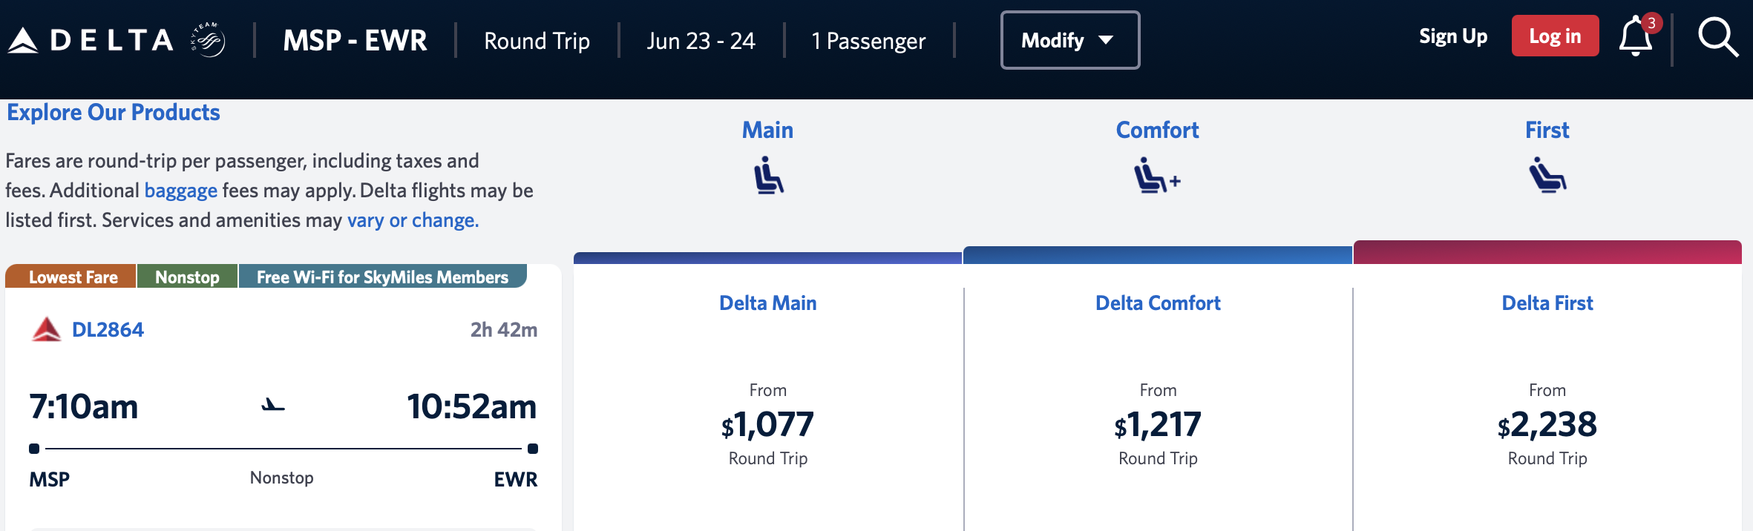
+40 +140 +270

Slide 37
+$140 +1,021
+40 +140 +270

Slide 38
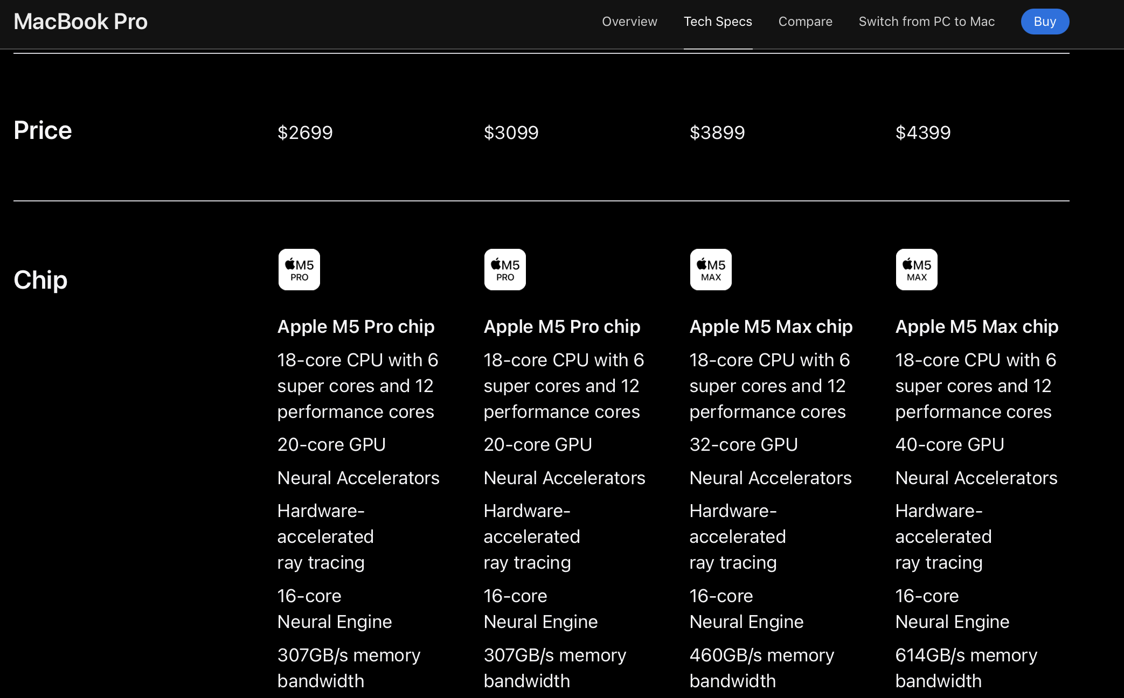
+$400 +$800 +$500

Slide 39
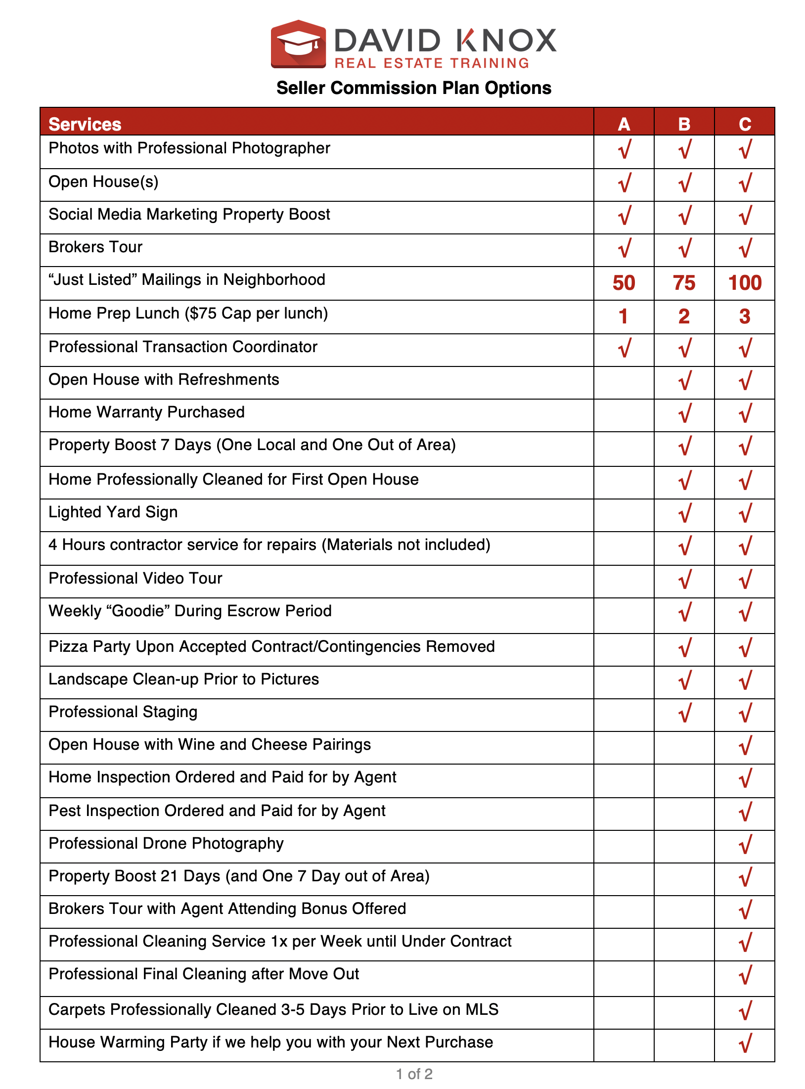
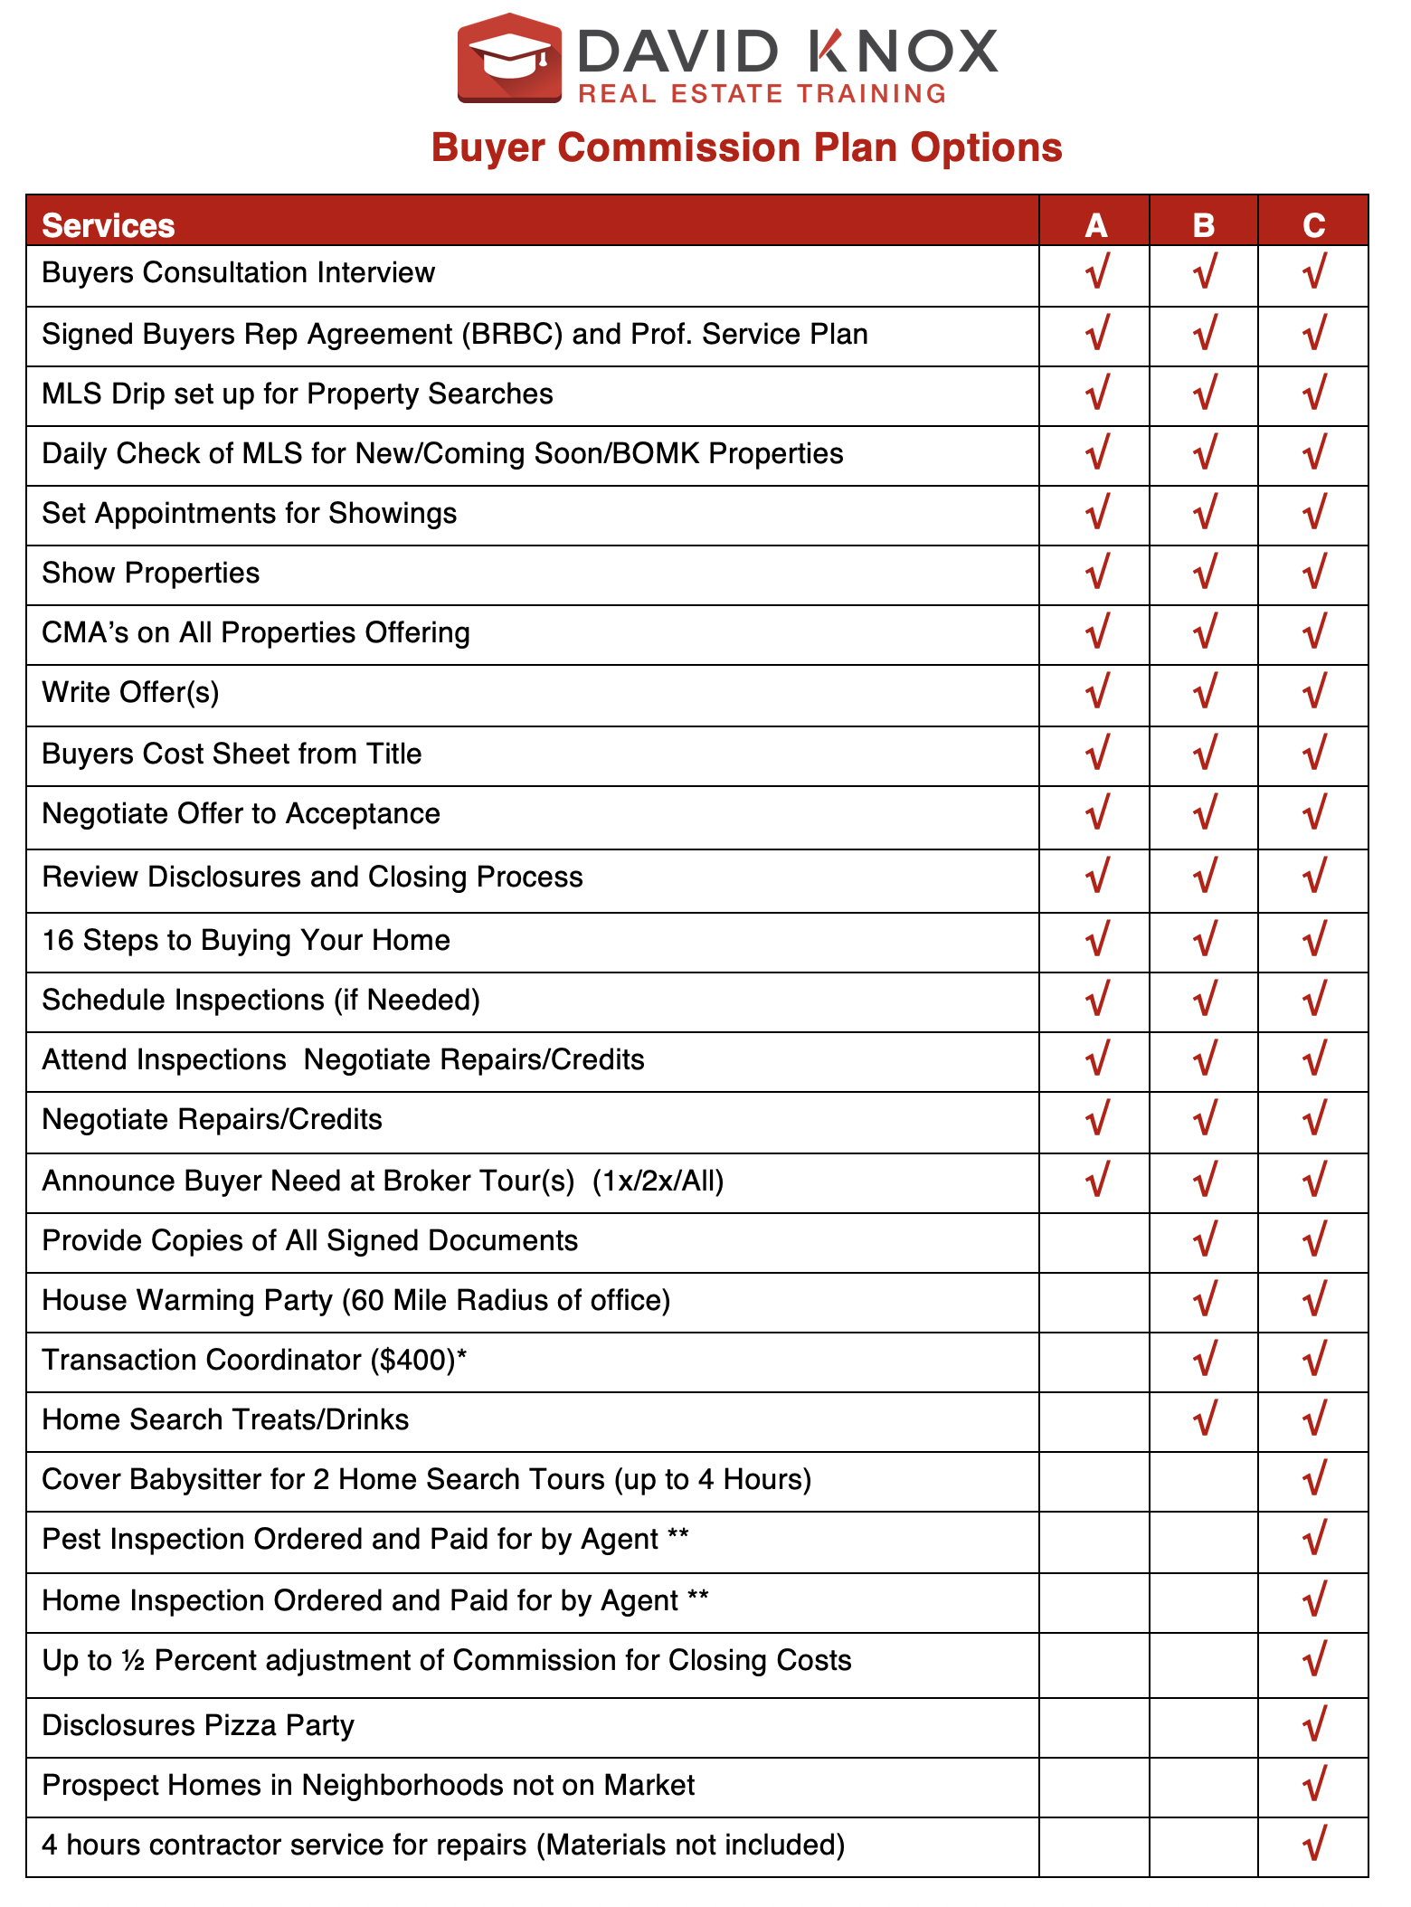

Slide 40
Negotiate Compensation

Slide 41
How to keep your commission
1. Value
2. Difference
3. Dialog
4. NET
5. Strength

Slide 42
Performance Differences
Sale to List ratio %
Days on Market
Expirations
Average price
Neighborhood market share
Per Person Productivity

Slide 43
P.A.I.D for Objections
Pause
Acknowledge
Isolate
Discover
P
A
I
D

Slide 44
Another company charges less
A: “If our fees were the same, who would you select?
S: “We’d go with you.“
A: Why?
S: “Because (itemize points of difference).”
A: “You see the benefits we offer over the competition.
Wouldn’t you expect there to be a commensurate difference in fee?”
“How would that affect price and time?”

Slide 45

Online Real Estate Training
RealEstateTrainingByDavidknox.com
$267/month
25 agents

